Slide 1
Maven Toy Data Analysis Using SQL
Arjun S Dileep
Data Analyst Intern
Batch Name: MIP-DA-14

Slide 2
Objective
To analyze and derive insights from Toy data to improve business decision-making process using SQL which will help in Leveraging sales trends, Improve Inventory efficiency, Enhance profitability, and forecasting future growth.

Slide 3
Dataset Descriptions – Column and Data Types
Inventory
Store_ID (Integer): Unique identifier for the store.
Product_ID (Integer): Unique identifier for the product.
Stock_On_Hand (Integer): Number of units available in stock.
Products
Product_ID (Integer): Unique identifier for the product.
Product_Name (Text): Name of the product.
Product_Category (Text): Category of the product (e.g., educational, plush, action figures, etc.).
Product_Cost (Integer): Cost price of the product.
Product_Price (Integer): Selling price of the product.

Slide 4
Dataset Descriptions – Column and Data Types
Sales
Sale_ID (Integer) : Unique identifier for the sale.
Date (Date): Date the sale was made.
Store_ID (Integer): Identifier linking to the stores table.
Product_ID (integer): Identifier linking to the products table.
Units (Integer): Number of units sold.
Stores
Store_ID (Integer): Unique identifier for the store.
Store_Name (Text): Name of the store.
Store_City (Text): City where the store is located.
Store_Location (Text): Location details of the store.
Store_Open_Date (Date): Date when the store was opened.

Slide 5
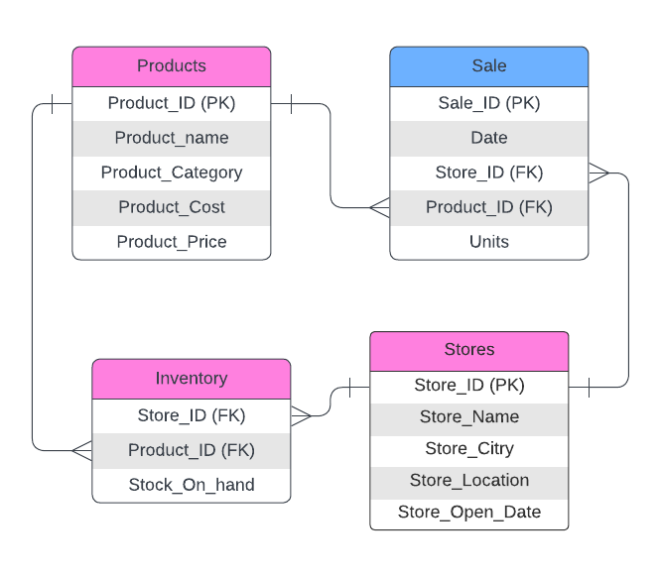
Database Schema
4 tables
Products
Sale
Inventory
Stores

Slide 6
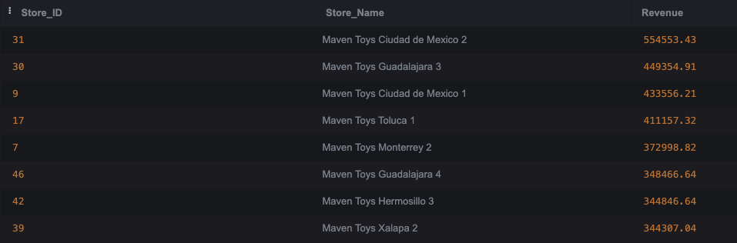
Task 1 - Total Sales Revenue Generated by Each Store

Slide 7
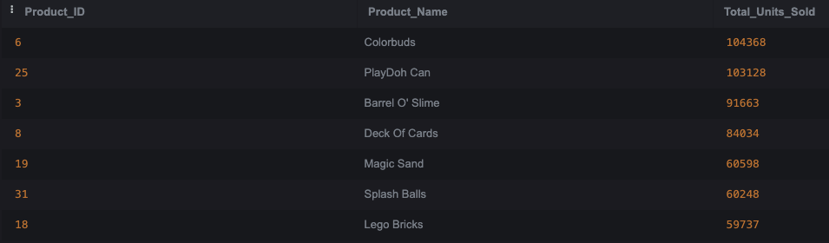
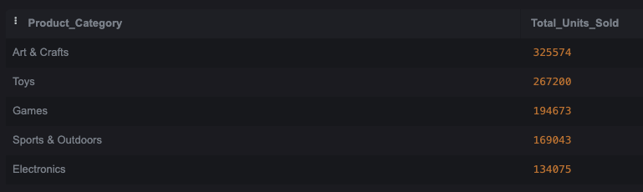
Task 2 - Top-Selling Products in Terms of Units Sold
Task 3 - Sales Performance by Product Category:

Slide 8
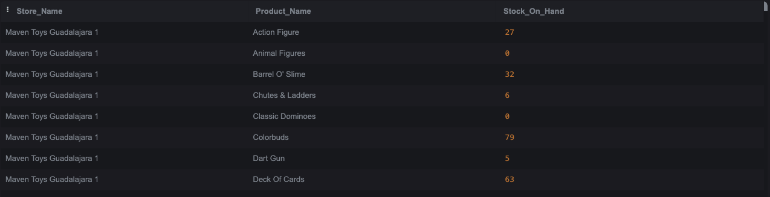
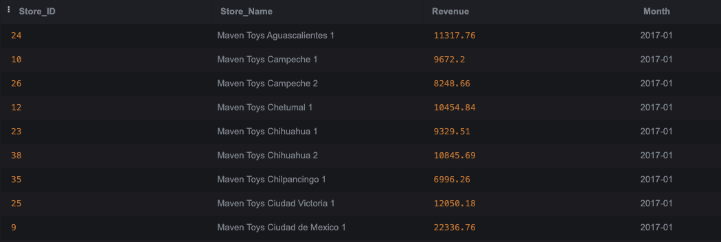
Task 4 - Current Inventory Levels for Each Product at Each Store:
Task 5 - Monthly Sales Trends Across Different Stores:

Slide 9
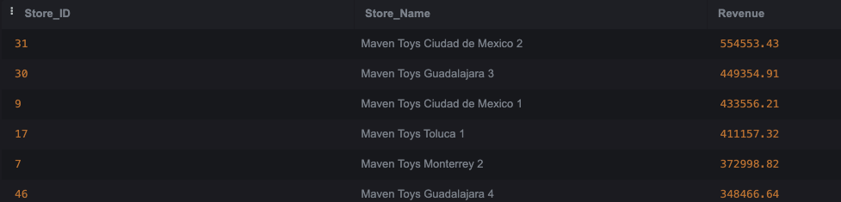
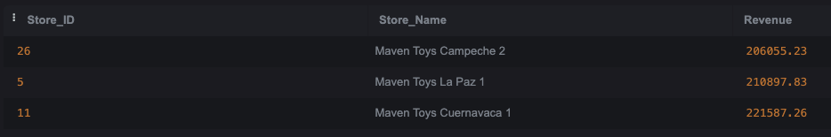
Task 6 - Stores with Highest and Lowest Sales Performance
Highest
Lowest

Slide 10
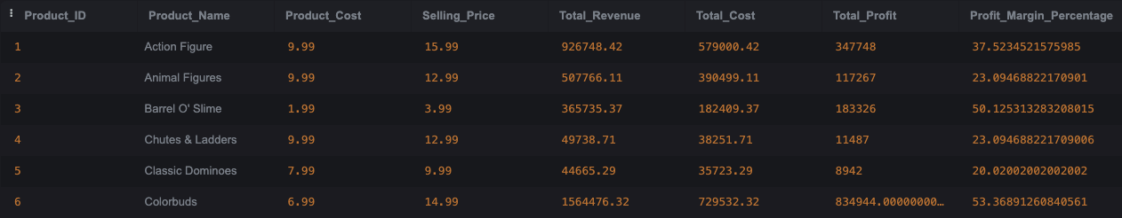
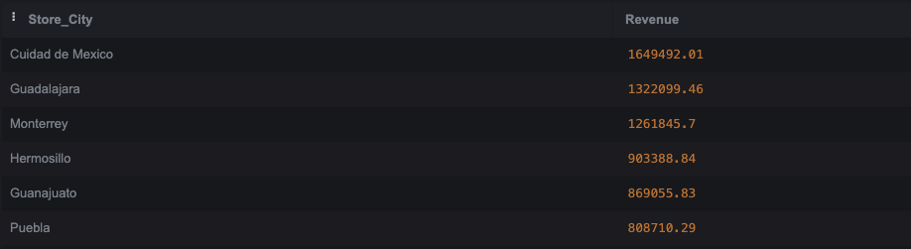
Task 7 - Profit Margin for Each Product:
Task 8 - Sales Distribution Across Different Cities:

Slide 11
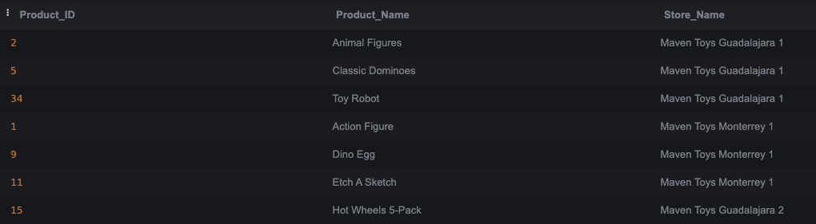
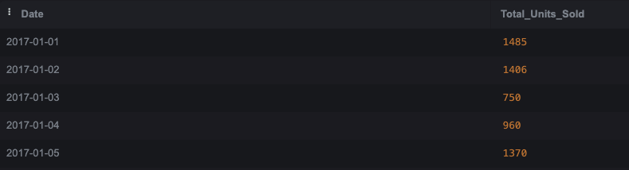
Task 9 - Products Out of Stock in Each Store:
Task 10 - Sales Variation by Specific Dates:

Slide 12
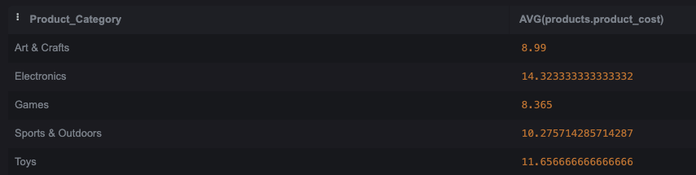
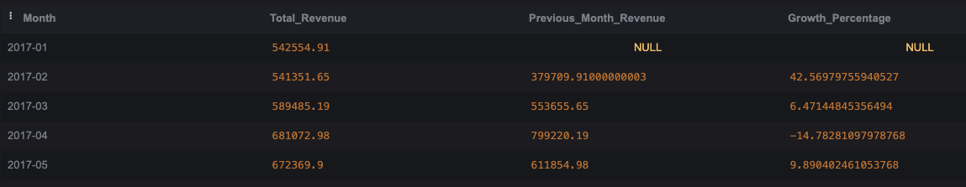
Task 11 - Average Cost of Products in Each Category:
Task 12 - Sales Growth Over Time for the Entire Company:

Slide 13
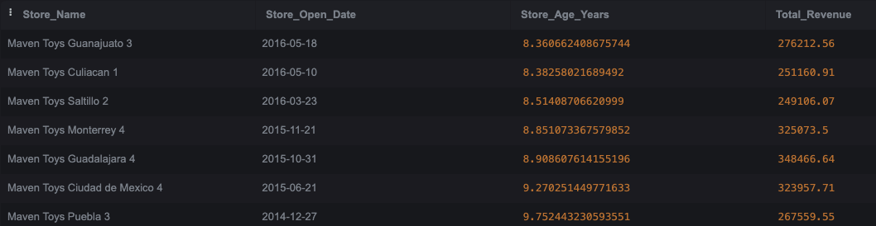
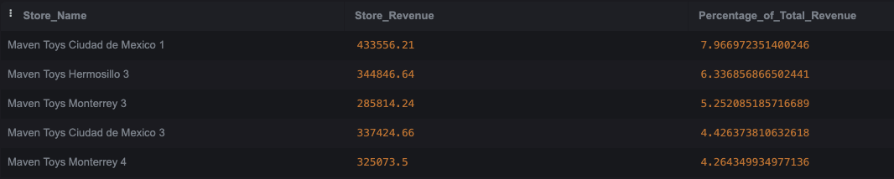
Task 13 - Impact of Store Open Date on Sales Performance:
Task 14 - Percentage of Total Sales Contributed by Each Store:

Slide 14
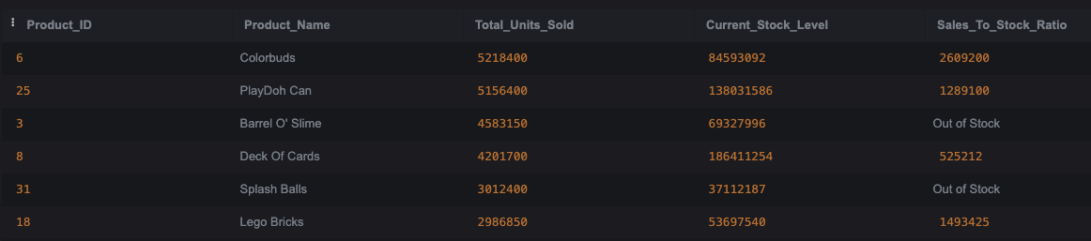
Task 15 - Sales Compared to Current Stock Levels for Each Product:

Slide 15
Recommendations
Implement dynamic inventory management systems to ensure popular products like "Colorbuds" and "PlayDoh Can" are always in stock, while adjusting stock levels for slow-moving items which reduces stockouts for high-demand products.
Focus marketing campaigns around periods of high sales growth, such as March and April, to maximize returns on promotional activities which Boosts revenue during peak demand periods.
For stores like Maven Toys Campeche 2, develop location-specific strategies, such as targeted promotions, revised product offerings, or localized advertising which will Increase sales at underperforming stores.

Slide 16

Thank You

